Slide 1


Department of Computer Science and Engineering
SMART CROP RECOMMENDATION SYSTEM
Mrs. M.Divya M.E.
Asst.professor,dept of cse,
Rajalakshmi Engineering College
Rudra S
(2116220701231)

Slide 2
Problem Statement and Motivation
Crop selection is a critical decision in agriculture, traditionally based on farmers' experience or outdated guidelines. These methods often ignore real-time environmental factors, leading to suboptimal yields and unsustainable farming practices.
With the rise of machine learning and access to real-time weather data, there's a growing opportunity to develop intelligent systems that recommend the most suitable crops based on current soil and climate conditions. This project aims to support precision agriculture by providing data-driven crop recommendations, improving productivity, sustainability, and farmer decision-making.

Slide 3
Existing System
Traditional methods mainly rely on farmer’s experience.
Static Guidelines: Crop selection follows general seasonal guidelines, not personalized or dynamic.
Manual Observation: Farmers rely on manual observations of environmental conditions.
Limited Adaptability: Existing systems don’t adjust to changing soil and weather conditions in real time.
Inaccurate Recommendations: Generalized suggestions can lead to inaccurate crop choices
Suboptimal Yields: Inability to adapt results in inefficient use of resources, like water and fertilizers.

Slide 4
Objectives
The main objective of this project is to develop a Smart Crop Recommendation System using machine learning to help farmers choose the most suitable crops based on real-time soil and weather conditions. It uses key soil parameters (N, P, K, pH) and weather factors (temperature, humidity, rainfall), with real-time data fetched via the OpenWeather API. The system aims to boost agricultural productivity through data-driven insights and offers a scalable, user-friendly web interface for easy access. The ultimate goal is to support precision agriculture and promote sustainable farming practices.

Slide 5
Abstract
This project introduces a Smart Crop Recommendation System using machine learning to suggest optimal crops based on soil (N, P, K, pH) and real-time weather data (temperature, humidity, rainfall) from the OpenWeather API. A Random Forest Classifier powers the model, offering accurate and adaptive recommendations. The system is deployed via a user-friendly Streamlit web interface, helping farmers make informed, sustainable crop choices through data-driven insights.

Slide 6
Proposed System
Data-Driven Recommendations: Uses machine learning (Random Forest) to suggest optimal crops based on real-time weather and soil conditions.
Key Inputs: Considers soil parameters (N, P, K, pH) and environmental factors (temperature, humidity, rainfall).
Real-Time Integration: Fetches weather data through OpenWeather API for dynamic, up-to-date suggestions.
User-Friendly Interface: Web-based platform for easy input of soil data and location to get instant crop recommendations
Promotes Precision Agriculture: Aims to increase productivity, sustainability, and resource efficiency in farming.

Slide 7
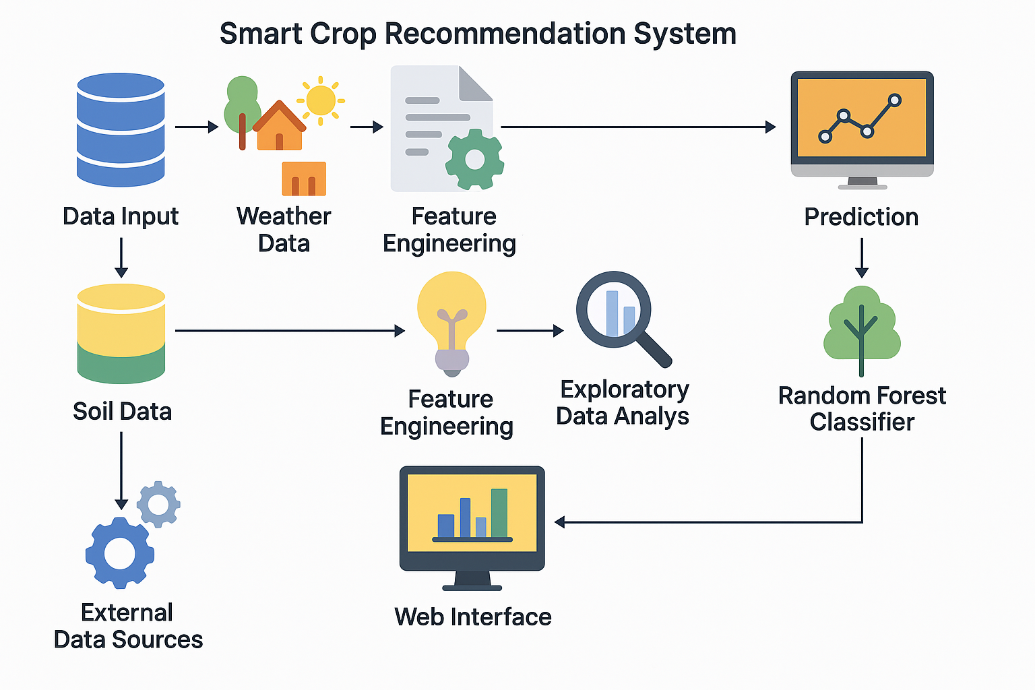
System Architecture

Slide 8
List of Modules
Data Collection: Gathering soil and weather data
Preprocessing: Normalize data, handle missing values, and select relevant features.
Model Training: Train Random Forest model with preprocessed data.
Real-Time Weather Integration: Fetch real-time weather data using OpenWeather API.
Crop Prediction: Generate top crop recommendations based on model output.
Web Interface: User-friendly platform for farmers to input data and get recommendations.
Model Evaluation: Assess model performance using metrics like accuracy and precision.

Slide 9
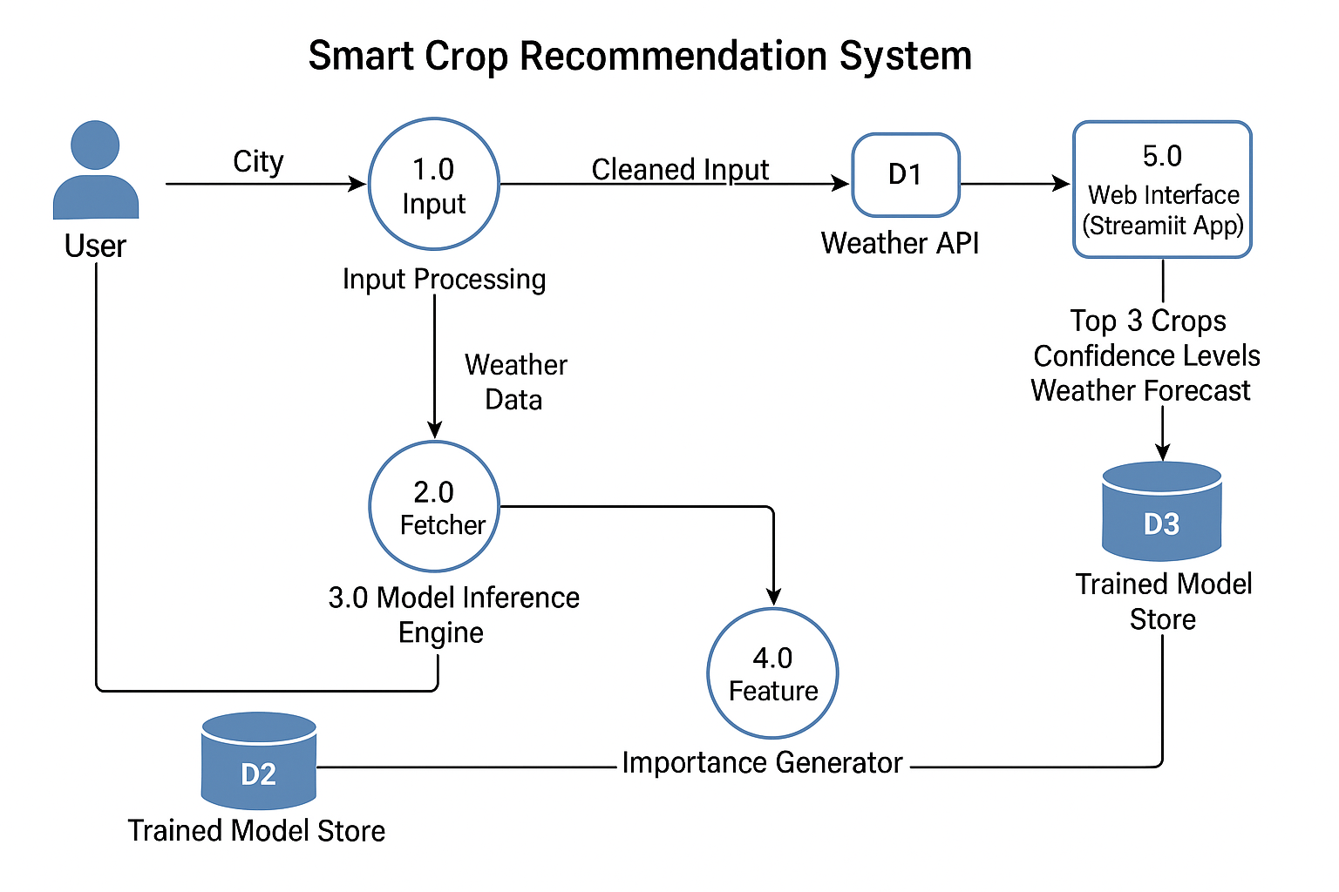
Functional Description for each modules with DFD and Activity Diagram

Slide 10
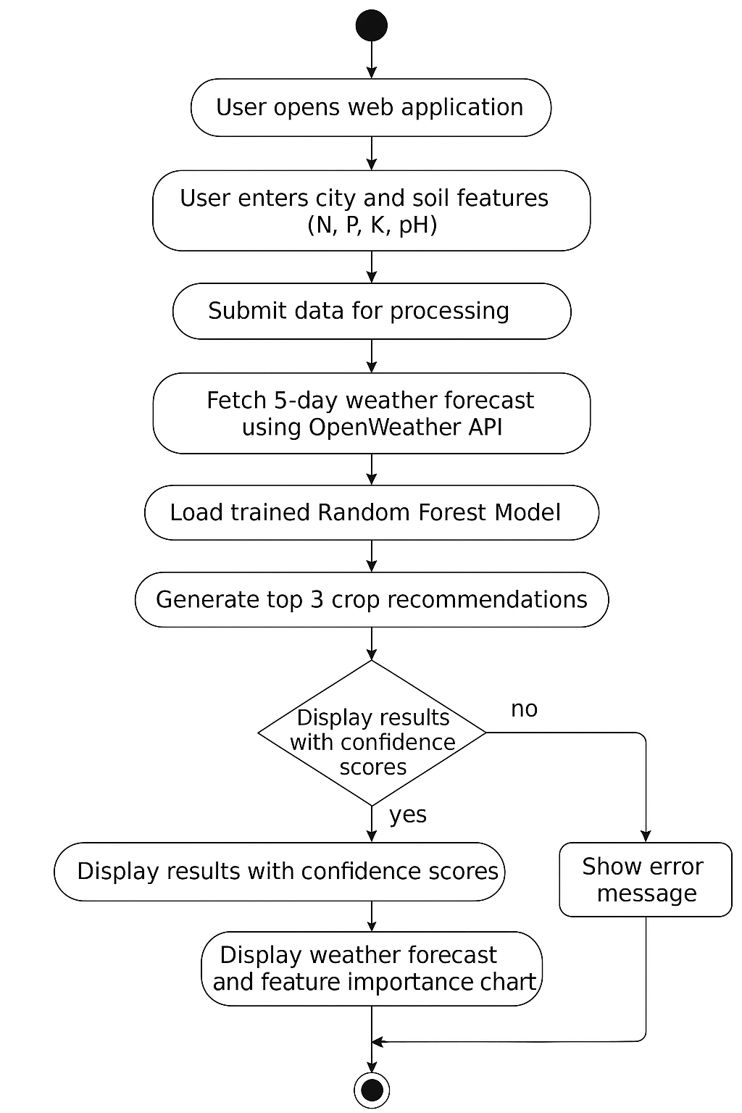
Functional Description for each modules with DFD and Activity Diagram

Slide 11
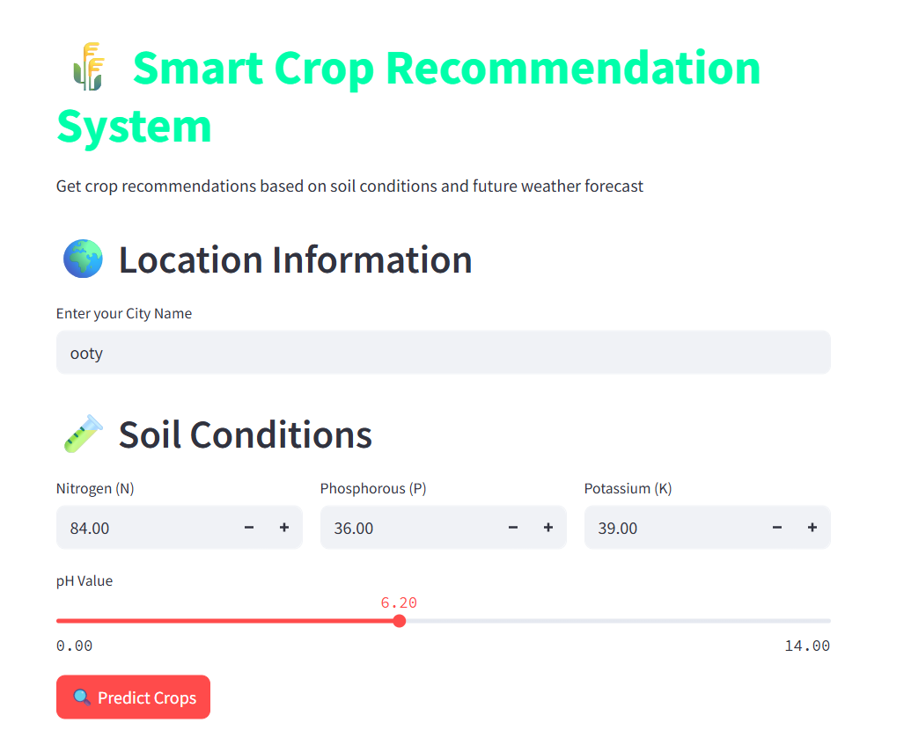
Implementation & Results of Module

Slide 12
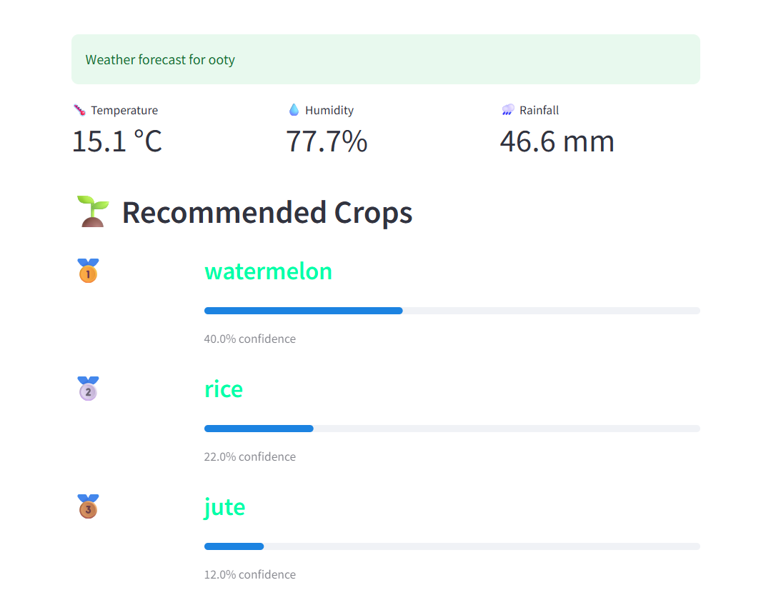
Implementation & Results of Module

Slide 13
Conclusion & Future Work
Conclusion:
The Smart Crop Recommendation System uses machine learning to provide personalized crop suggestions based on soil and weather data. By integrating real-time weather information and key soil parameters, the system helps farmers make better decisions, improve productivity, and promote sustainable farming. It is user-friendly and scalable, offering instant crop recommendations based on location and soil inputs.

Slide 14
Conclusion & Future Work
Future Work:
Add More Features: Include factors like soil moisture and pest data for better predictions.
Explore Advanced Algorithms: Test deep learning models to handle more complex data.
Personalized Advice: Offer tailored recommendations for irrigation and fertilization.
Real-Time Updates: Integrate live weather data and crop health monitoring.
Cross-Region Testing: Validate the system in various farming environments.

Slide 15
References
Jha, S., & Mishra, A. (2022). Machine Learning for Agricultural Crop Prediction and Recommendation: A Review. Journal of Agricultural Technology, 18(3), 456-472.
Sharma, V., & Singh, R. (2021). Real-Time Weather Data Integration for Precision Agriculture. Journal of Environmental Informatics, 35(2), 200-213.
Patel, A., & Kumar, R. (2020). Utilizing Random Forest for Crop Yield Prediction and Optimization. International Journal of Agricultural Science, 8(6), 320-334.
Singh, M., & Yadav, P. (2022). Smart Crop Recommendation Systems: Integration of Soil and Environmental Data for Sustainable Farming. Journal of Precision Agriculture, 12(4), 415-429.

Slide 16
Thank You

